Slide 1
Business Essentials
Ebert, Griffin, Starke, Dracopoulos
8th Canadian Edition

Slide 2
CHAPTER 6
Managing the Business Enterprise

Slide 3

Learning Objectives
Describe the four functions that constitute the management process.
Identify types of managers by level and area.
Describe the five basic management skills.
Explain the importance of setting goals and strategic management in organizational success.
Discuss contingency planning and crisis management in today’s business world.
Explain the idea of corporate culture and why it is important.
Notes:
These learning objectives are based upon those at the beginning of the chapter. For a review of learning objectives, see the summary at the end of the chapter, as well as the list of key terms.

Slide 4


ENVIRONMENTAL SCAN
“Managing” – Look both inside and outside.
100: We Look INSIDE and OUTSIDE the org.
General Environment:
Political
Economic
Social
Technological
Demography
Business Environment:
Customers
Suppliers
Competitors
Many other stakeholders!
Inside the Org:
Structure / Functions
Fin/Acct HRM
Operations Marketing

Slide 5
The Management Process
(LO 6-1)
Planning
Leading
Functions of Management
Organizing
Controlling
Notes:
26
26
Learning Objective: 6-1
Page(s): 124-126
Notes
Management- A series of activities developed to allow businesses to achieve their goals
Planning
Leading
Organizing
Controlling

Slide 6
Functions of Planning
Planning
  determining what the business needs to do and the best way to achieve it
Organizing
  determining how to use existing resources to implement the plan
  arranging jobs in a structure to create an efficient task system
Leading:
managers monitor the firm’s performance
  guiding and motivating subordinates to meet objectives
  managers have various responsibilities with regard to their employees
  Controlling: managers monitor the firm’s performance
Notes:
These learning objectives are based upon those at the beginning of the chapter. For a review of learning objectives, see the summary at the end of the chapter, as well as the list of key terms.

Slide 7
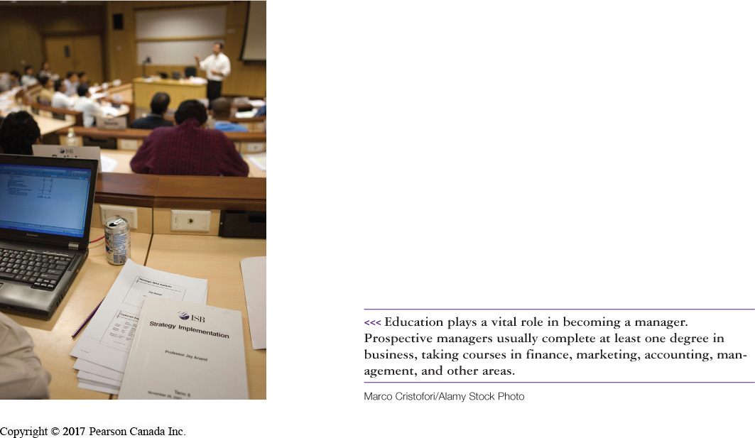
The Management Process
(LO 6-1)
Planning
  determining what the business needs to do and the best way to achieve it
Strategic plans
Tactical plans
Operational plans
Notes:
26
26
Learning Objective: 6-1
Page(s): 125

Slide 8


Contingency Planning and Crisis Management
(LO 6-5)
Contingency Planning
  identify in advance changes that might occur
  identify ways the company can respond to changes
Crisis Management
  methods for dealing with emergencies
Notes:
24
24
Learning Objective: 6-5
Page(s): 137-138

Slide 9
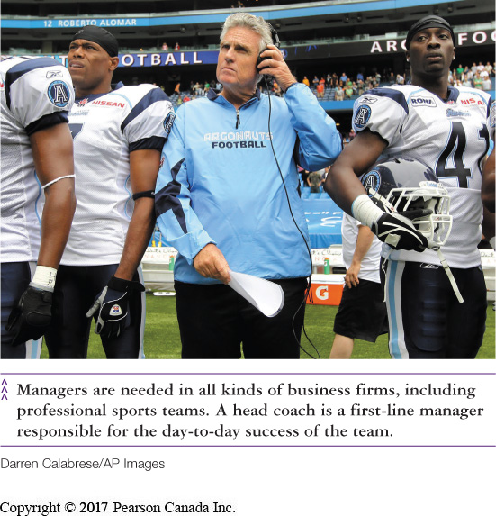
The Management Process
(LO 6-1)
Organizing
  determining how to use existing resources to implement the plan
  arranging jobs in a structure to create an efficient task system
Notes:
28
28
Learning Objective: 6-1
Page(s): 125

Slide 10
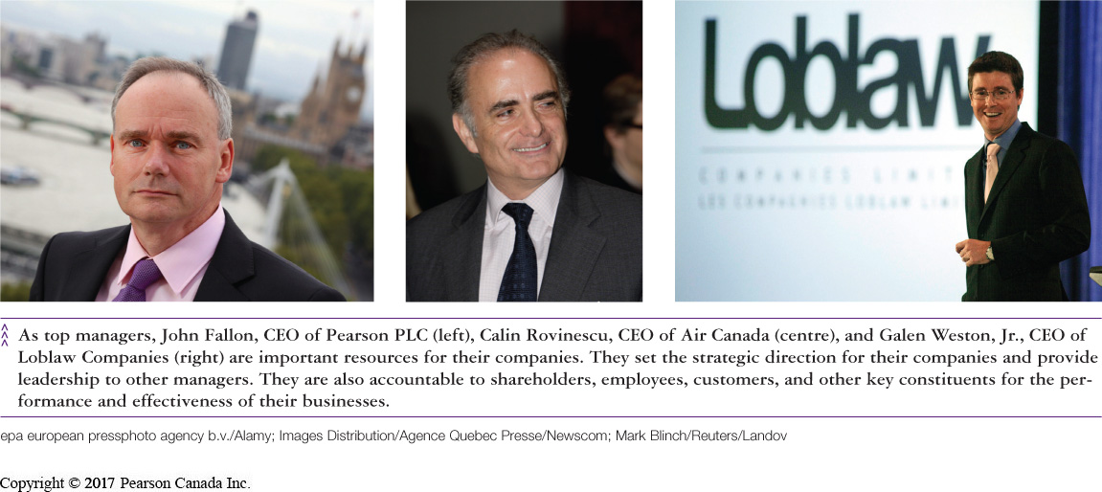
The Management Process
(LO 6-1)
Leading
  guiding and motivating subordinates to meet objectives
  managers have various responsibilities with regard to their employees
Authority to give orders
Ability to guide employees
Power to motivate subordinates
Notes:
29
29
Learning Objective: 6-1
Page(s): 125-126

Slide 11
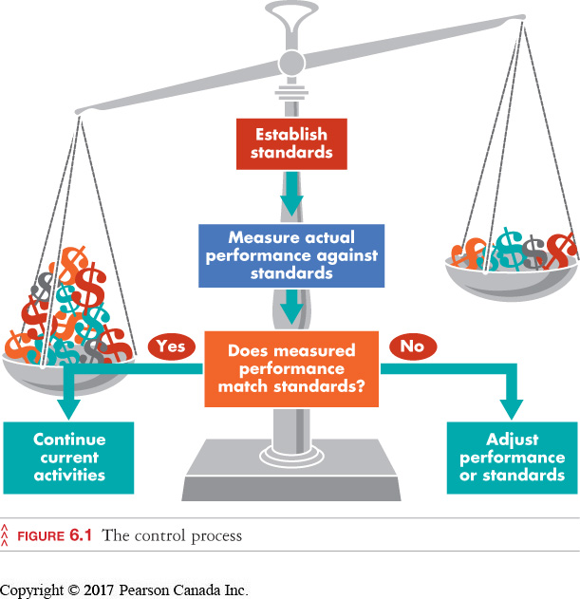
The Management Process
(LO 6-1)
Controlling: managers monitor the firm’s performance
Notes:
30
30
Learning Objective: 6-1
Page(s): 125
Figure 6.1

Slide 12
Questions of Planning
What is the situation now in your project?
Where do you want to go? (mark, timeline,1st place …)
How can you get there from here?
Consider “work before play” / “play before work”

Slide 13
Basic Management Skills
(LO 6-3)
Decision-Making Skills – 6 steps
Recognize and define the decision situation
Identify alternatives
Evaluate the alternatives
Select the best alternative
Implement the chosen alternative
Follow up and evaluate the results
Notes:
Learning Objective: 6-3
Page(s): 131
Table 6.2

Slide 14





Setting Goals and Formulating Strategy
(LO 6-4)
SMART Goals
Specific
Measurable
Achievable
Relevant
Time-Framed
Notes:
Learning Objective: 6-4
Page(s): 134

Slide 15
Approaches to Leadership
Leadership Styles
  many managers use one style but some may use a combination of styles depending on the situation
Autocratic
Democratic
Free-Rein
Notes:
Learning Objective: 9-7
Page(s): 215
Notes
Autocratic: Orders are issued and expected to be obeyed without questions
Democratic: Manager requests input from workers before making decisions but ultimately makes the final decision
Free-rein: Subordinates given a lot of discretion in making decisions. The manager becomes an advisor

Slide 16
Strategic Management: Setting Goals and Formulating Strategy (LO 6-4)
Mission Statement
  how the organization will achieve its purpose (reason for being)
  clarifies who the organization serves, what it offers, and how it will be provided
  includes core values and ethical commitment
Notes:
6
6
Learning Objective: 6-4
Page(s): 133
Notes
While companies may have the same purpose, their mission may be different. Example:
-the purpose of a consulting business is primarily to seek profit
-the mission statement may be: “to provide affordable solutions to small and medium businesses...”

Slide 17
QUICK-CHECK QUESTIONS
2) When Jasmine analyzes monthly sales figures for her flower shop, and uses this information to determine the optimal variety of flowers to order for next month, she is involved in the _________ function of the management process.
A) leading
B) planning
C) controlling
D) organizing
Answer:
C) Controlling – she is controlling the variety of flowers

Slide 18
QUICK-CHECK QUESTIONS
Effective goal setting is helped by comparing the outcomes to the SMART guideline. What does SMART stand for?
  A) Specific, Measurable, Achievable, Relevant, and Time-framed
  B) Simple, Mature, Achievable, Responsible and Time-Framed
  C) Simple, Maximized, Achievable, Reliable and Time-Framed
  D) Specific, Mature, Aggressive, Realistic and Time-Framed
Answer:
A) Specific, Measurable, Achievable, Relevant, and Time-framed

